Slide 1

Intermediate Presentation
SVBRDF Estimation using a Physically-based Differentiable Renderer Markus Andreas Worchel

Slide 2
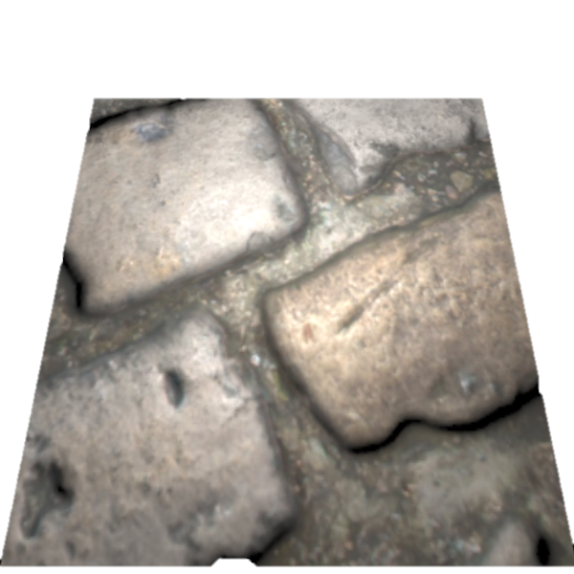
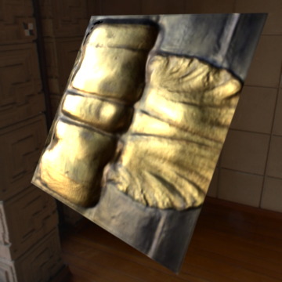
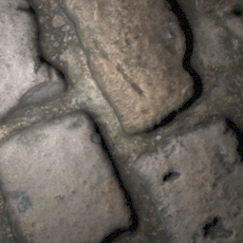
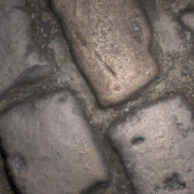
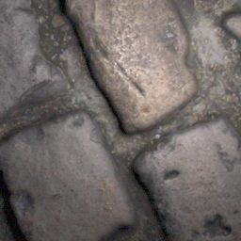
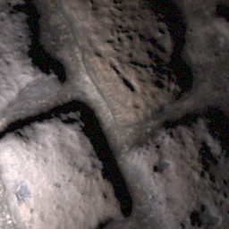
Recap – Topic
Physically-based
Differentiable Renderer
…
CNN
…
…
…
…

Slide 3
Recap – Schedule
Download database
Acquire testing and training code for the network
Get familiar with papers, source code and data
Acquire code for Mitsuba 2
Replace rendering layers of the network with Mitsuba 2
Evaluation (compare with unmodified method)

Slide 4
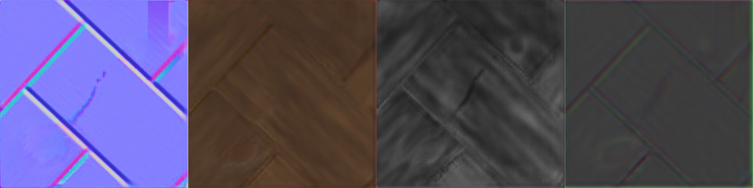
Data
Database

Slide 5
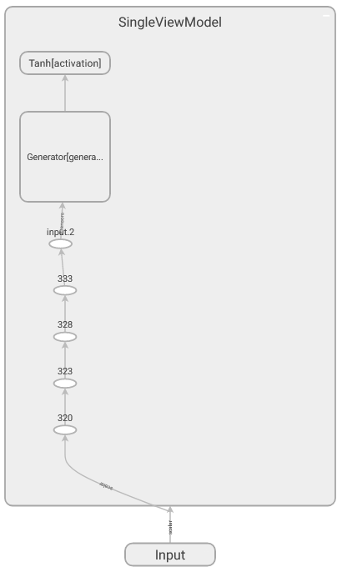
Models
Single-view Model (Deschaintre et al., 2018)
Implement in pyTorch ✓
Verify model using visualization in TensorBoard ✓
Report bugs back to author ✓
Multi-view Model (Deschaintre et al., 2019)
Implement in pyTorch ✓ → Only 40 LoC more than single-view model
Verify model using visualization in TensorBoard –

Slide 6

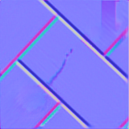

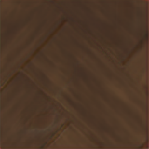
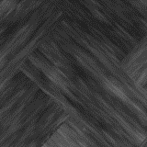
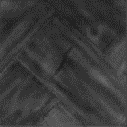



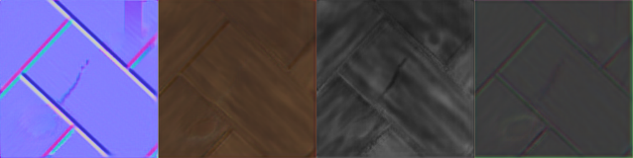
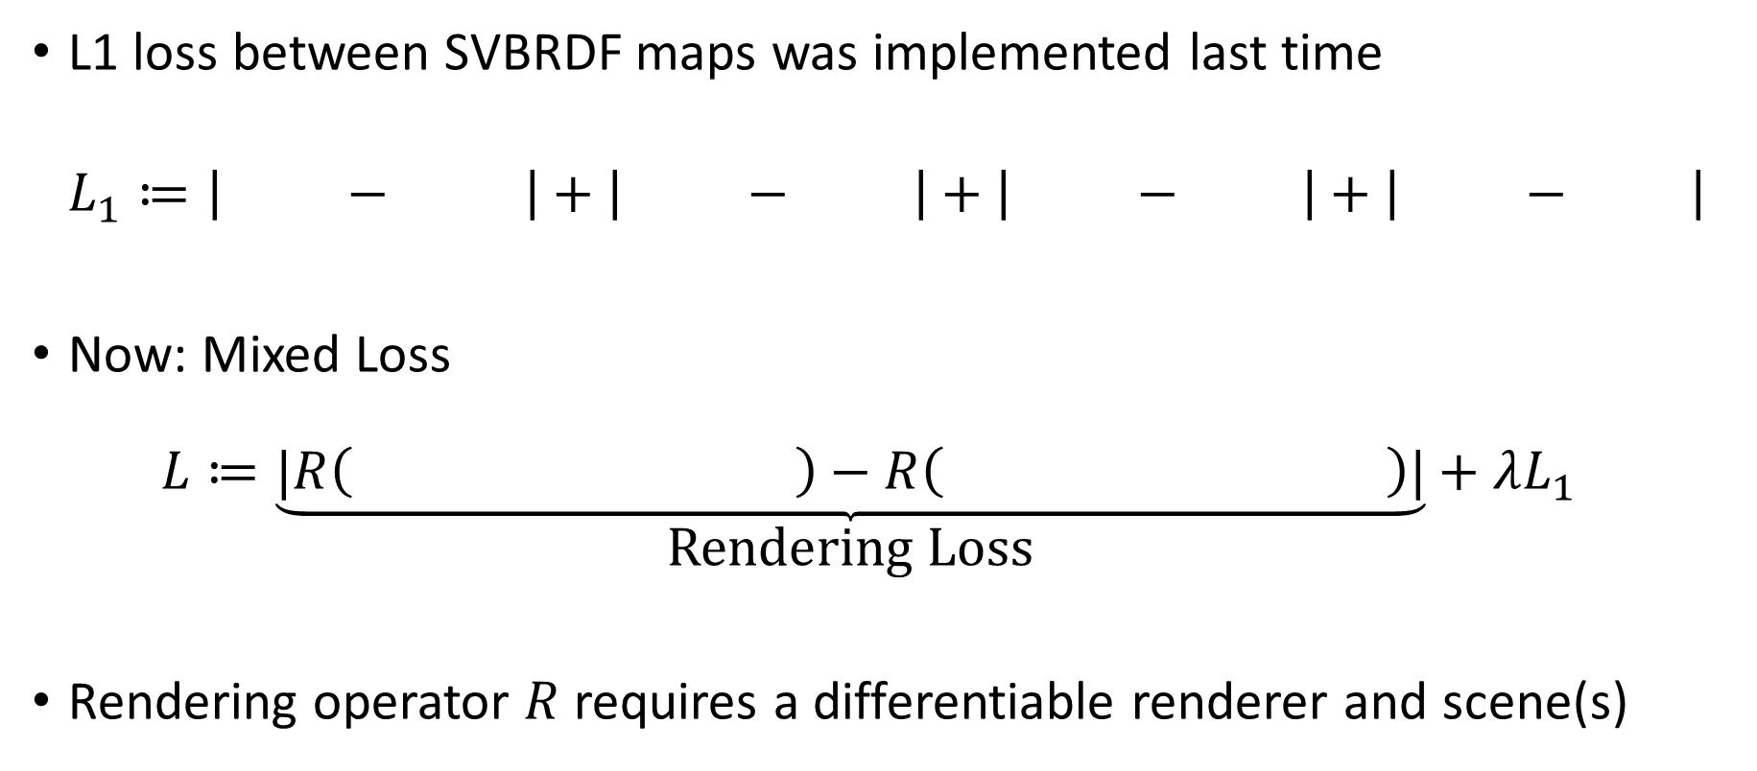
Loss – From L1 to Mixed Loss
L1 loss between SVBRDF maps was implemented last time
$$L_{1}≔\left| − \right|+\left| − \right|+\left| − \right|+\left| − \right|$$
Now: Mixed Loss $L≔\underset{\text{Rendering} \text{Loss}}{\underbrace{|R\left( \right)−R\left( \right)|}}+λL_{1}$
Rendering operator $R$ requires a differentiable renderer and scene(s)

Slide 7
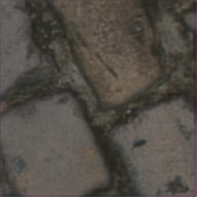
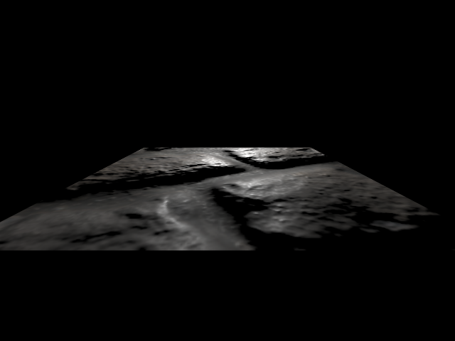
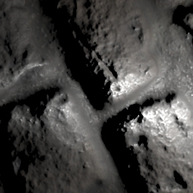
Loss – Renderer
Implement simple differentiable renderer ✓
Only considers direct illumination
Lambertian diffuse term
Cook-Torrance specular model
Renders SVBRDF on flat material patch in the origin (virtual orthographic camera)
💡
📷
Perspective
Orthographic

Slide 8
Loss – Scenes
Scenes used in Rendering Loss
One camera, one light ✓
Randomly sampled camera and light positions per mini batch –
Required for unbiased appearance comparison
Currently only three fixed configurations
Multiple Lights –

Slide 9
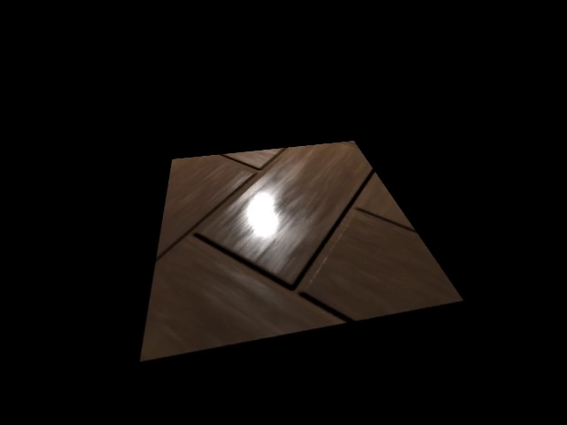
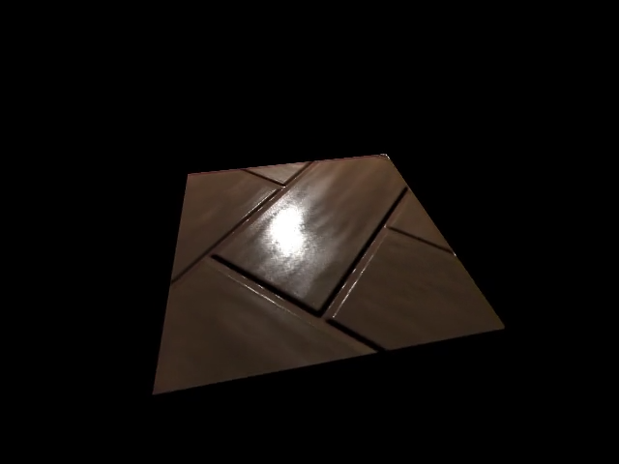
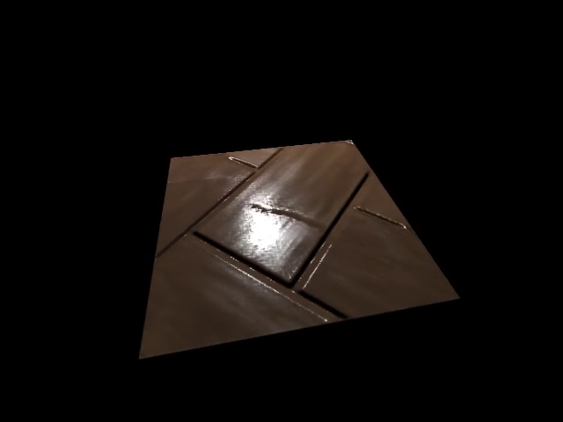
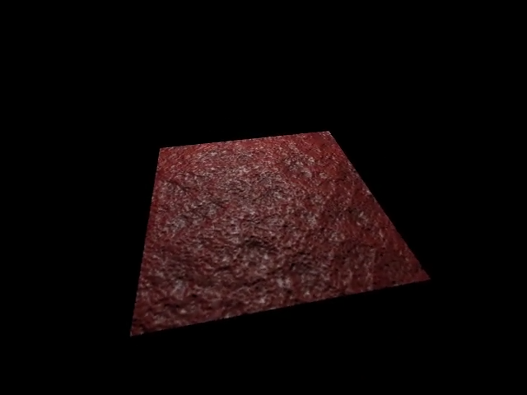
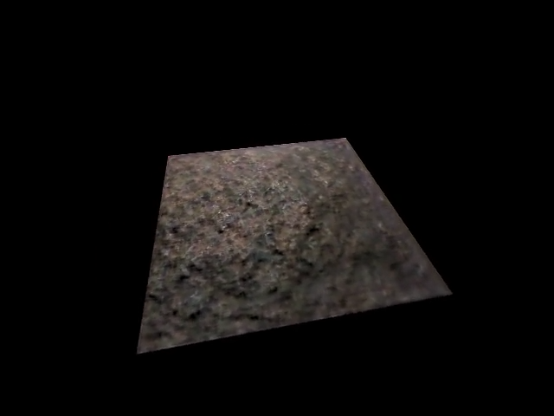
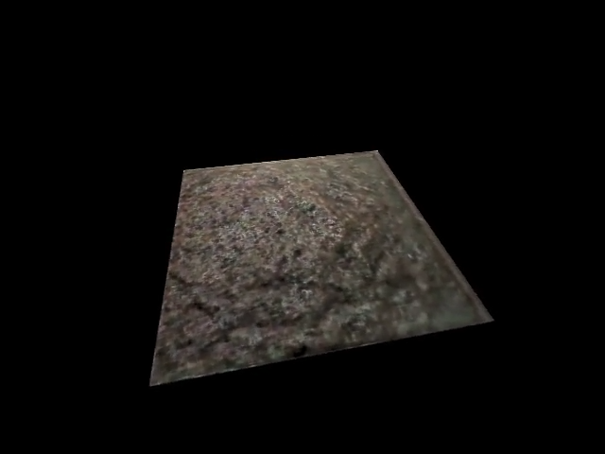
Loss – Results
Input
Ground Truth
L1 Loss
Mixed Loss (L1 + Rendering)

Slide 10
Loss – Replacing the Simple Renderer
Mitsuba 2 still not released
Fall back to Redner ✓
Redner is not compatible with Windows
Patch Redner code (MSVC intrinsics, install script) ✓
Send PR to upstream repository ✓
Uses OpenEXR python bindings (no Windows compatibility)
Patch OpenEXRPython code ✓
Send PR to upstream repository ✓
Redner GPU (CUDA) not compatible with Windows
Patch Redner Code –
Send PR to upstream repository –

Slide 11
Loss – Replacing the Simple Renderer
Challenges
Integration into Rendering Loss and current structure
Orthographic rendering
CUDA compatibility
Significantly increased training time
Evaluation

Slide 12
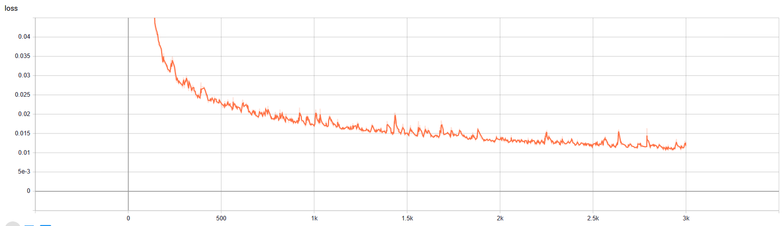

Slide 13
Schedule
Download database
Acquire testing and training code for the network
Contact authors for training code
Fallback: Re-implementation
Acquire code for Mitsuba 2
Not yet officially released
Fallback: Use other renderer like render (Li et al., 2018)
Get familiar with papers, source code and data
Replace rendering layers of the network with Mitsuba 2
Evaluation (compare with unmodified method)

